Slide 1
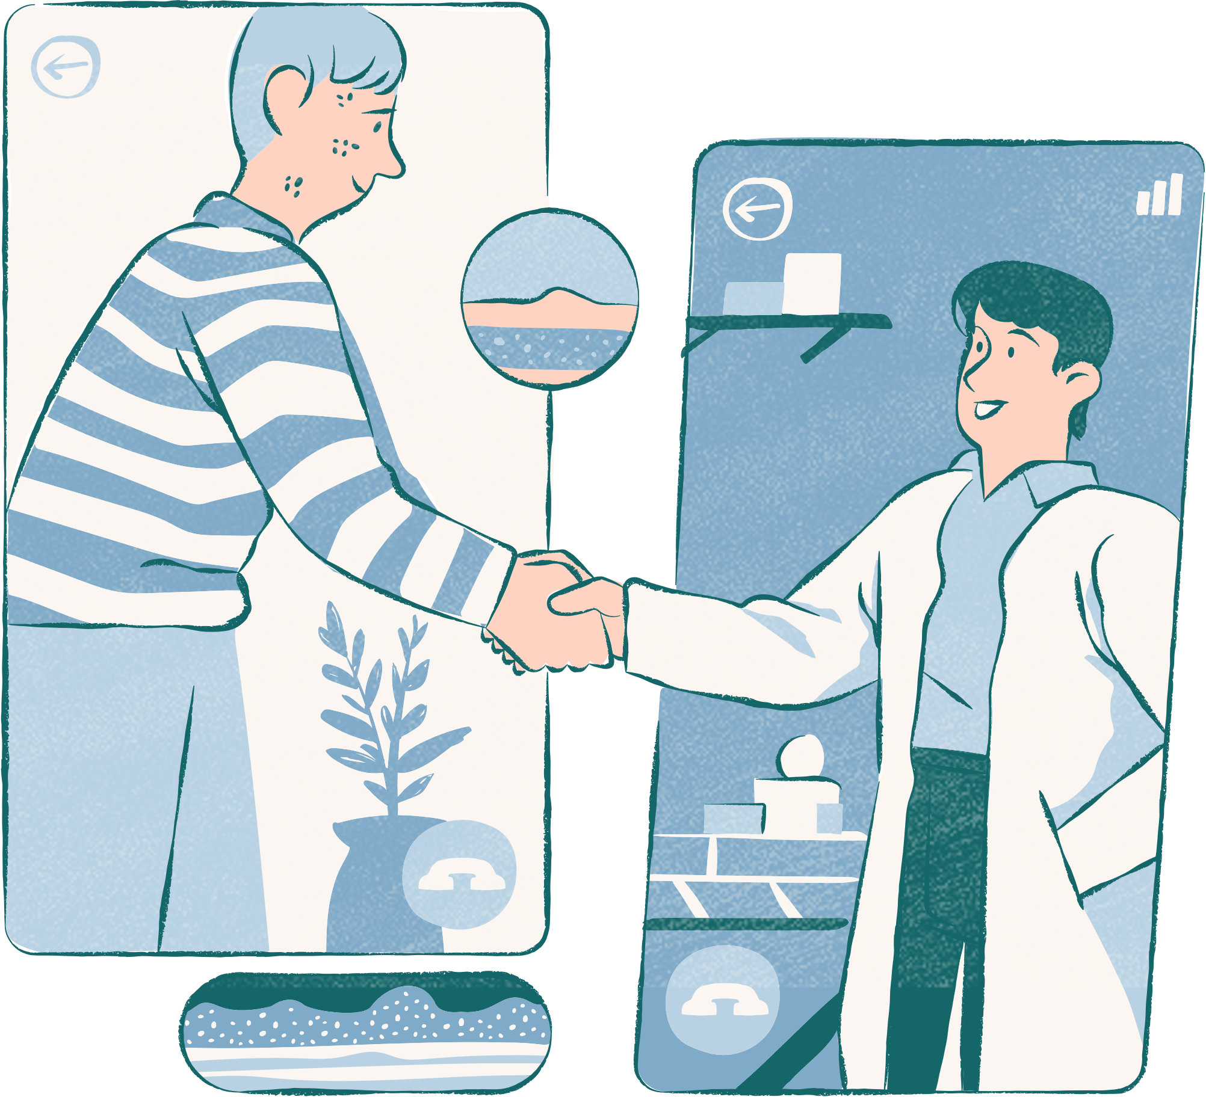
Dental Clinic Synchronization: Managing Dentist and Patient Activities Using POSIX Threads and Semaphores
Presented By
Tasnova Haque Mazumder
Amin Ocin
Akash Ahmed
2021-3-60-235
2021-3-60-135
2021-3-60-242

Slide 2
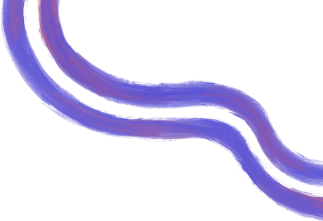
Navigating the Intricacies of Dentist-Patient Synchronization
A Three-Step Approach
Dental Clinic Operations
01
02
03
Resource Allocation
Interaction & Synchronization
Cleanup & Termination
The core problem is to ensure that the dentist and patients are coordinated, considering a limited number of waiting room chairs.
Simulate the flow of patients in the clinic and ensure proper synchronization between the dentist and patients.
Gracefully end all processes after all patients have been treated.

Slide 3


Clinic Workflow
Input Initialization
Interaction & Synchronization
Gather input for the total number of patients and chairs
01
05
Handle the dentist's states of activity, from sleeping when no patients are available to waking up when notified by an arriving patien
Semaphores
Flow & Waiting Room Optimization
Initialize semaphores for dentist and patients
02
06
Assess chair availability to direct incoming patients to either wait or leave.
Mutex Locks
Thread Termination
Set up mutex locks for patient management and waiting room management
03
07
"Terminate patient threads post-treatment and end the dentist thread after all patients are done
Threads
Resource Deallocation
Create threads for the dentist and patients
04
08
End the main program to free up all allocated resources

Slide 4
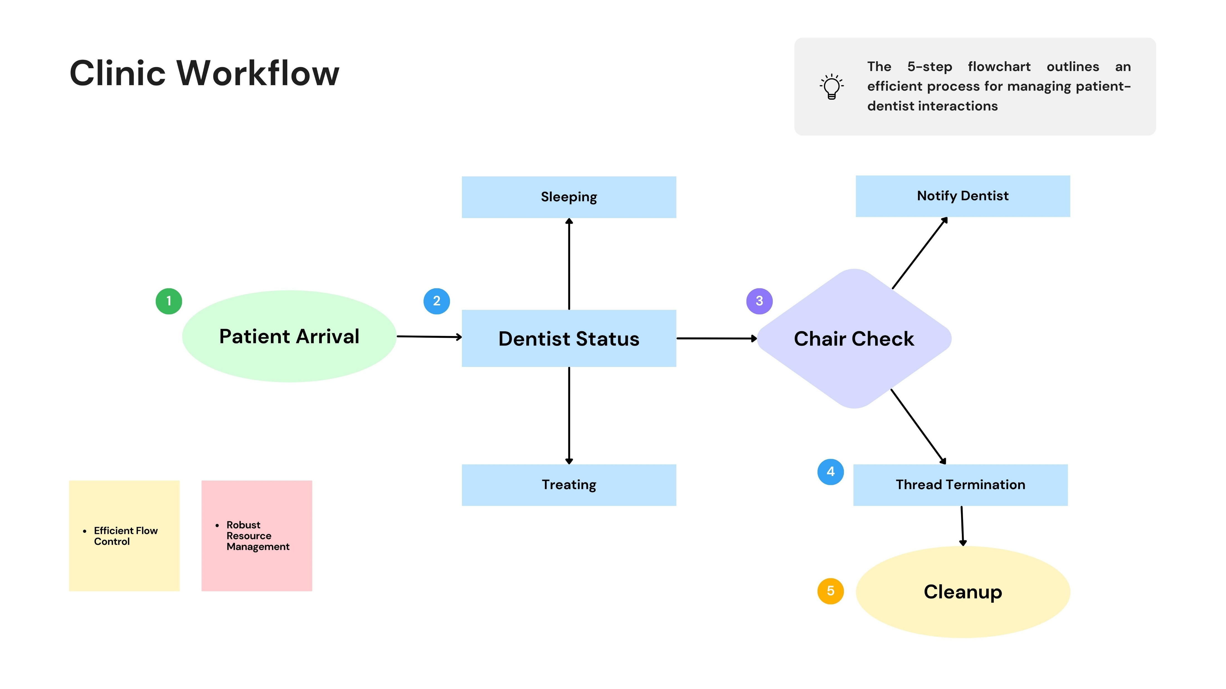

Slide 5
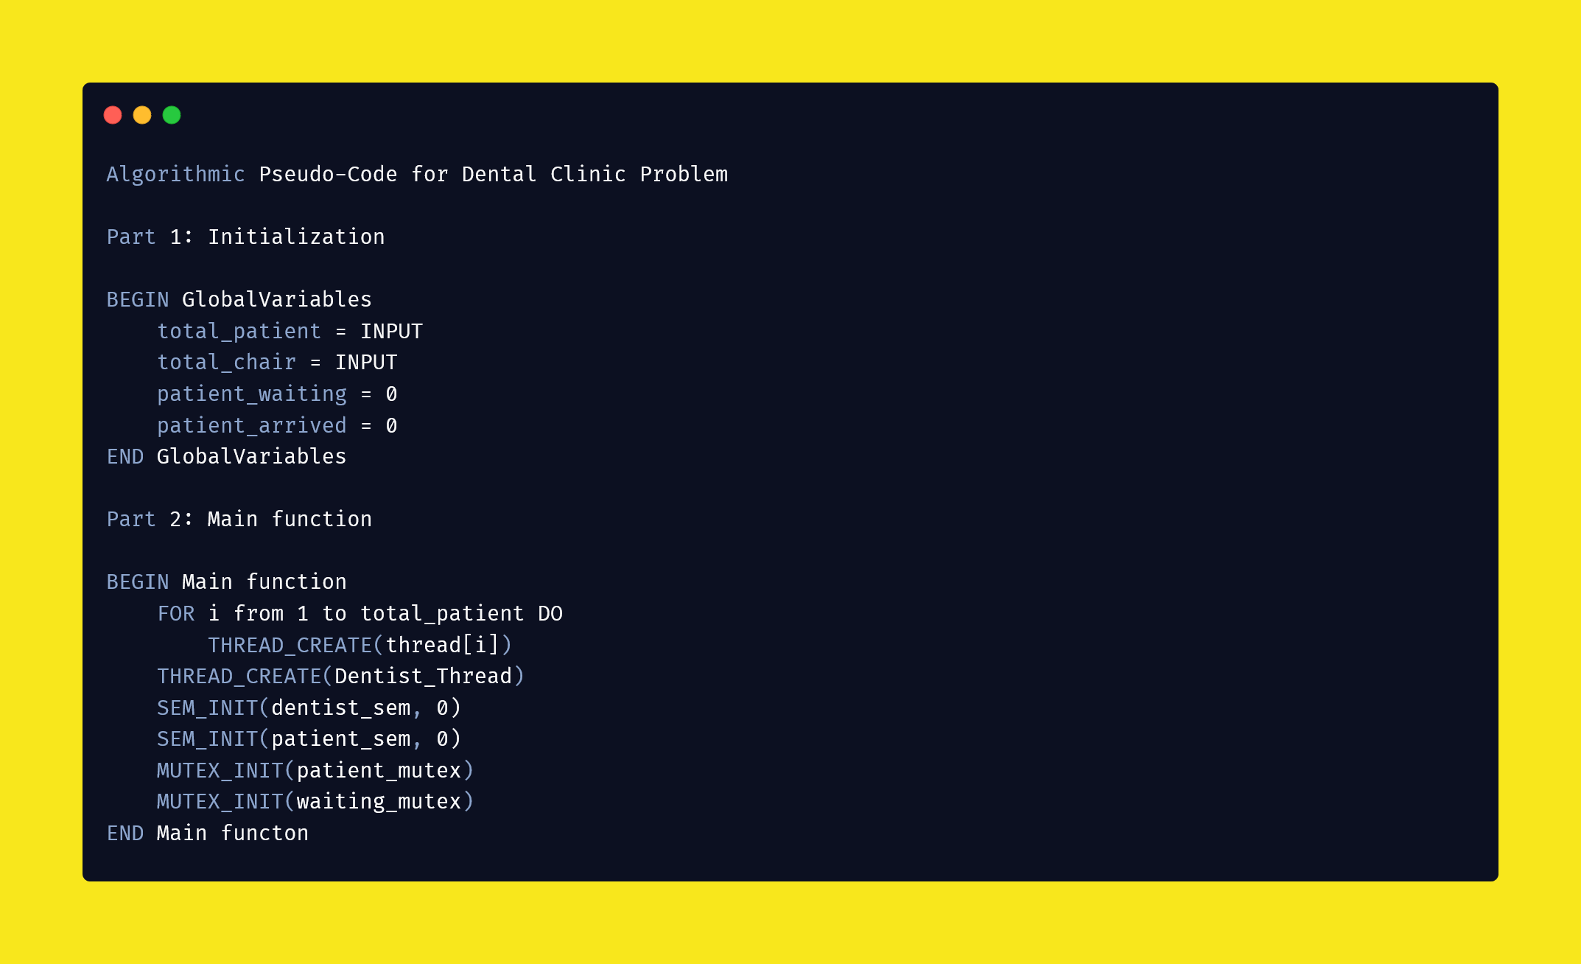

Slide 6
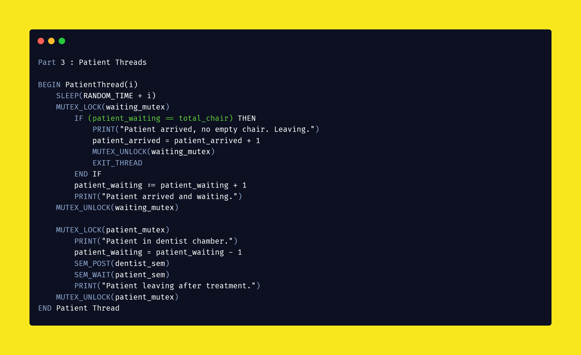

Slide 7
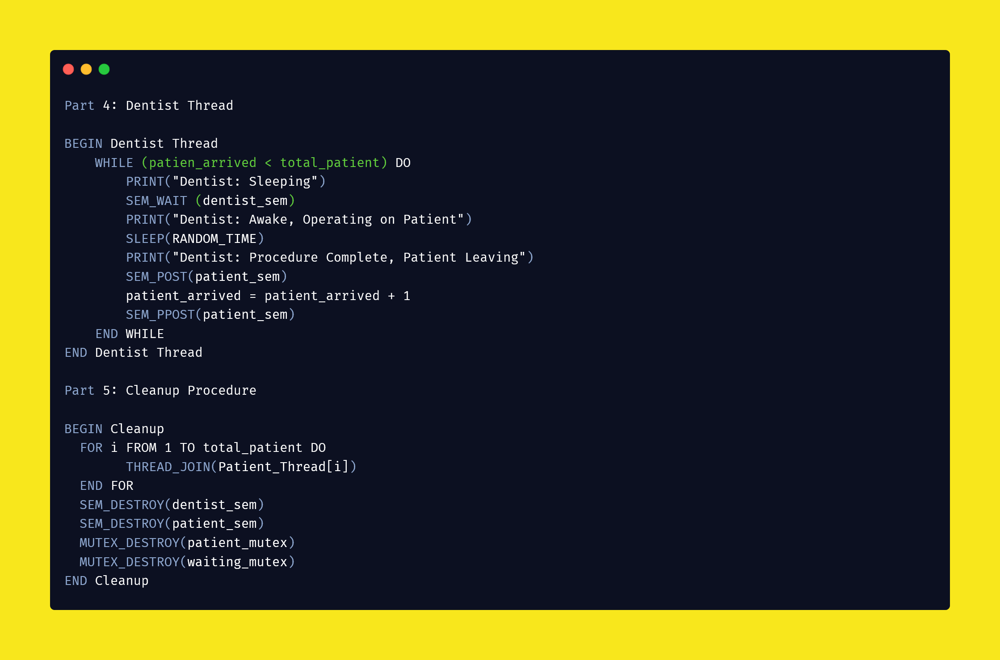

Slide 8
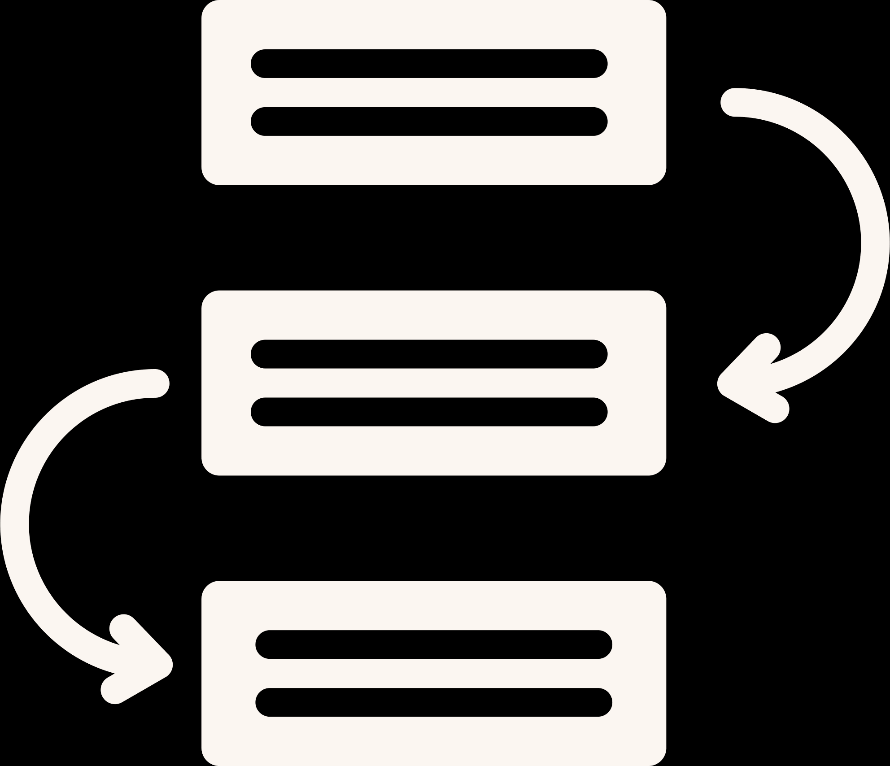


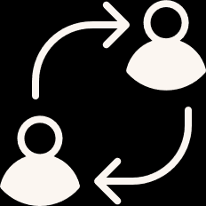


OUTPUT ANALYSIS
SEQUENTIAL FLOW
CONCURRENT ACTIVITIES
LIMIT CASES
TREATMENT COUNT
PATIENT TURNOVER
PROGRAM TERMINATION
"Dentist Awake, Operating on Patient" should be followed by "Procedure Complete, Patient Leaving" and then "Dentist Sleeping".
Multiple "Patient Arrived and Waiting in the Waiting Room" messages should appear in between the dentist's actions
When the waiting room is full, "Patient Arrived, No Empty Chair Available. Leaving" should appea
The number of "Procedure Complete, Patient Leaving" should match the number of "Dentist Awake, Operating on Patient"
The number of patients who arrived should be equal to those treated plus those who left due to lack of chairs
Program should terminate gracefully after all the patients have been treated or have left due to no availability,

Slide 9



Competitor Analysis
Usability
The program provides detailed output of its state at every significant step, aiding in debugging and understanding the system's status
Scalability
The code is designed for only one dentist and a fixed number of chairs, which limits its scalability.
Dynamic Input
The code is capable of working with a dynamic number of patients and chairs, which are given as inputs at the start of the program.

Slide 10



Enhancements
Appointment
Scheduling
Multiple Dentists
Priority Queuing
Extend the code to handle more than one dentist. This will make it closer to a real-world scenario and also make the scheduling part more challenging
Data will provide concrete insight into an issue because he data doesn’t lie
Implement a priority queue for patients based on criteria like appointment time, urgency of treatment, etc

